Slide 1

ARMOR: A Formally Verified Implementation
of X.509 Certificate Chain Validation
Joyanta Debnath¹, Christa Jenkins¹, Yuteng Sun²,
Sze Yiu Chau², and Omar Chowdhury¹
¹ Stony Brook University
² The Chinese University of Hong Kong
45th IEEE Symposium on
Security and Privacy (2024),
San Francisco, California

Slide 2




X.509 PKI and Authentication
X.509 PKI is a widely used
authentication and
key distribution mechanism
EAP-TLS
SMIME
SSL/TLS
X.509 PKI provides a framework to issue and manage digital certificates
Code Signing
X.509
PKI
Certificate contains a verifiable binding between an identity and its public key
SSL/TLS
Client
Server
Certificate
Validation
Certificate is required to be validated
to obtain trust on the certificate owner
…
IPSec

Slide 3


Certificate Chain Validation
Server sends a chain of certificate
EAP-TLS
SMIME
Root CA Certificate
Intermediate CA
Certificate
Code Signing
X.509
PKI
Client
Server
Server
Certificate
Certificate
Chain
Validation
Logic (CCVL)
…
IPSec
RFC 5280

Slide 4
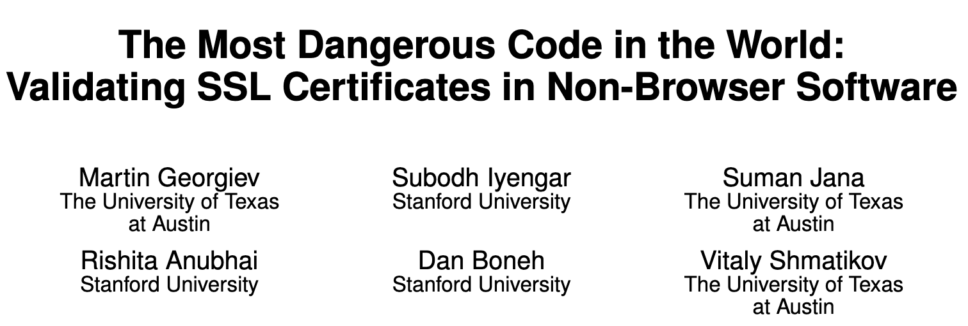
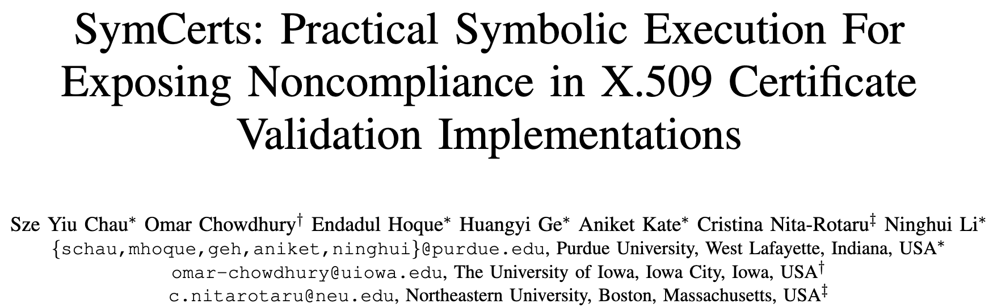





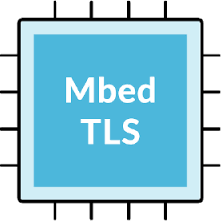
X.509 CCVL Implementations
Many Open-source
TLS (X.509 CCVL) Implementations
“In general, X.509 validation is one of the most error prone, code bloating, and compatibility nightmares in TLS implementation.”
BoringSSL
Client
MITM
Attacker
Server
GnuTLS
Incorrect certificate validation
Many related logical bugs
get reported in CVE

Slide 5


Overarching Objective
Development of a formally verified
implementation for X.509 CCVL
Why do we need formal verification?
Is program testing not sufficient?
Edsger W. Dijkstra
“By choosing provably secure software libraries, developers can ensure the components they are using are less likely to contain vulnerabilities.”
“Program testing can be used to show the presence of bugs, but never to show their absence!”

Slide 6

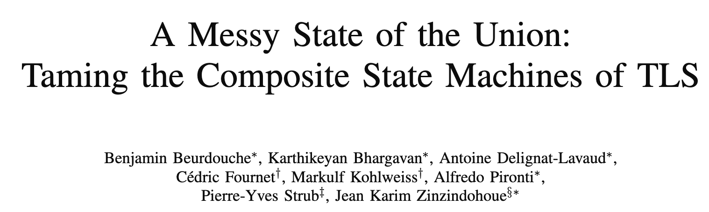

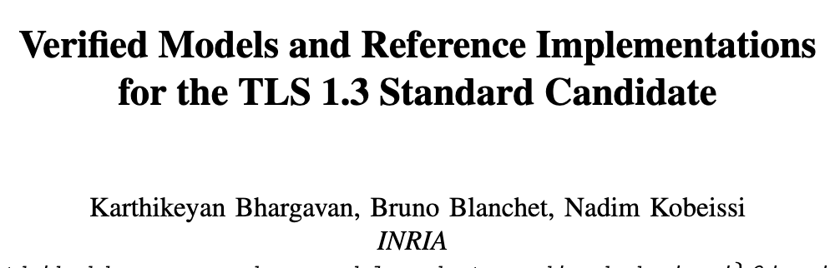
Overarching Objective
Development of a formally verified
implementation for X.509 CCVL
Assumes, underlying
X.509 CCVL is correct
Verified TLS implementations

Slide 7


Use Cases
Development of a formally verified
implementation for X.509 CCVL
Acts as an oracle (ground truth) for
testing other implementations
Gives a reliable reference for
application developers writing CCVL programs

Slide 8
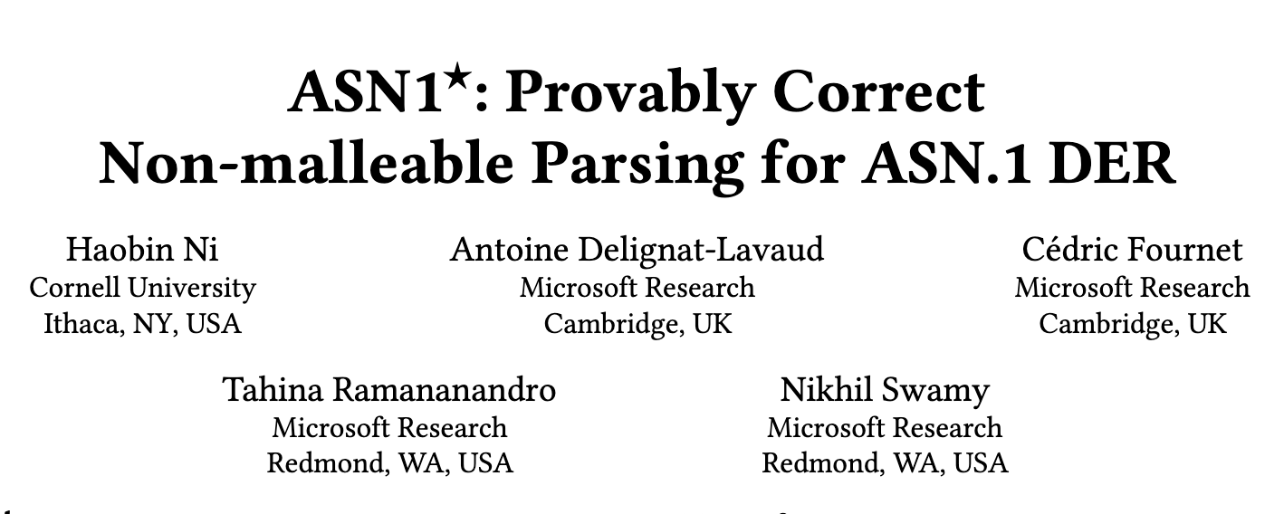
Our Contributions
ARMOR
An X.509 CCVL implementation with
machine-checked correctness proofs
First work that focused on formal correctness beyond certificate parsing
No explicit proof of soundness and completeness
Generic parser generator for
ASN.1 DER
(limited to parsing)
Provided implementation-independent relational specification
Proved total correctness (soundness, completeness, termination) for a large subset
of the CCVL

Slide 9
Outline for Rest of the Talk
Challenges and Philosophy
Correctness Properties and Proofs
Results
Lessons Learned

Slide 10



Notable Challenges
Writing a correct parser for a context-sensitive language (e.g., DER representation of the X.509 certificate)
Understanding and correctly interpreting the natural language specification
Devising formal correctness guarantees and prove some desired properties

Slide 11

Design Philosophy
Parser modules decodes input certificates
Modular
Decomposition
String canonicalizer normalizes the
strings in Issuer and Subject Names
Chain builder generates candidate chains
Semantic validator enforces core chain validation logic
Driver for
co-ordination
Chain
Builder
ARMOR
Semantic
Validator
String
Canonicalizer
Parser Modules
PEM
Parser
Base64
Decoder
X.690 DER
and X.509 Parsers

Slide 12
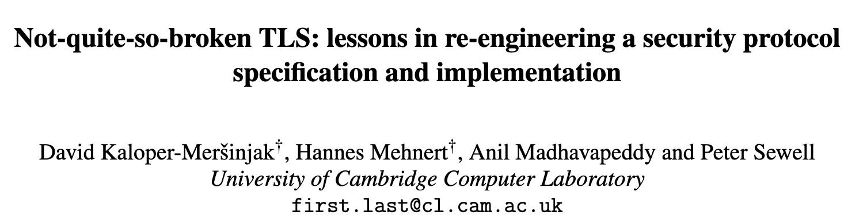
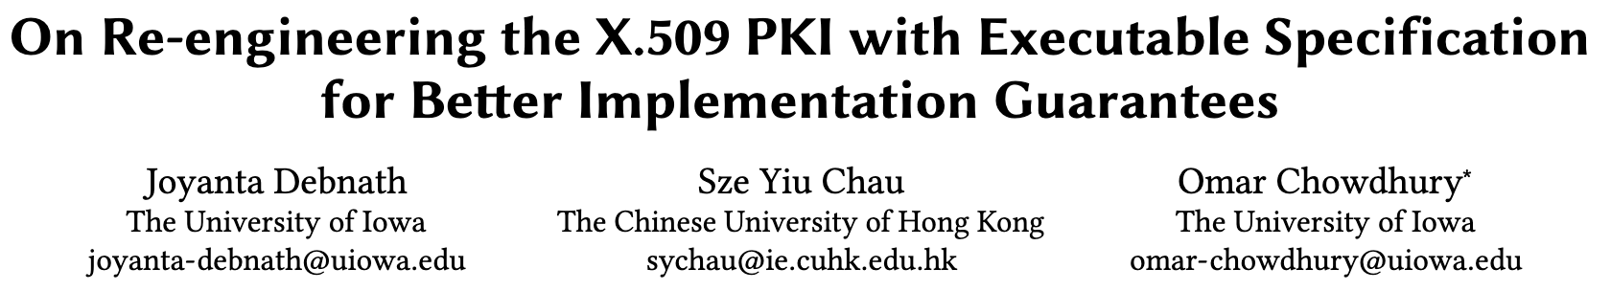
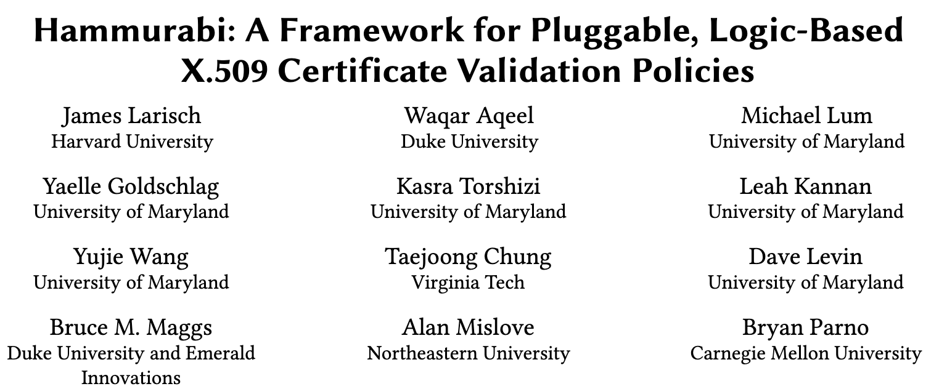
Design Philosophy
Modular
Decomposition

Slide 13

Verification Philosophy
Relational
Specification
Developing and proving implementation-independent
relational specification of components, when possible
def sort_list(L):
for i in range(len(L)):
for j in range(i + 1, len(L)):
if L[j] < L[i]:
L[i], L[j] = L[j], L[i]
return L
For a given list L,
the output S must satisfy:
∀x, count(x, S) = count(x, L)
∀i ∈ {1,2,…,n−1}, S[i] ≤ S[i+1]
Executable
specification of selection sort
Relational
Specification of any sort algorithm
Clear separation between the correctness of specification and implementation
An alternative to the natural language specifications

Slide 14


Verification Outcome
No end-to-end correctness guarantees
Verified Modules
Agda is dependently typed functional programming language and Interactive Theorem Prover
Unverified Modules
Does not support hostname verification and certificate revocation checking
Python
Driver for coordination
Chain
Builder
ARMOR
Agda
Semantic
Validator
String
Canonicalizer
Agda
Agda
PEM
Parser
Base64
Decoder
X.690 DER
and X.509 Parsers
Agda
Agda
Agda

Slide 15

Verification Outcome
ARMOR is the most comprehensive effort so far
in terms of formal verification of X.509 CCVL

Slide 16
Properties of X.509 Parser and Specification
Let p be the parser for the language specification ɸ,
and i be an input byte string
Total Correctness
Soundness
Completeness
Termination
For any prefix pfx of i,
Accepts(p, pfx, i) → pfx in ɸ
For any prefix pfx of i,
pfx in ɸ → Accepts(p, pfx, i)
Recursion will always reach a base case and terminate.

Slide 17
Properties of X.509 Parser and Specification
Let p be the parser for the language specification ɸ,
and i be an input byte string
Which prefix to consume?
How does the internal-data
look like?
Completeness
For any prefix pfx of i,
pfx in ɸ → Accepts(p, pfx, i)
Expected properties
of the language ɸ
Unambiguity
UniquePrefixes
One input byte string cannot be the encoding of two distinct data
At most one prefix of an input byte string is in the language

Slide 18
Properties of X.509 Parser and Specification
Let p be the parser for the language specification ɸ,
and i be an input byte string
Strong Completeness
For any prefix pfx of i,
pfx in ɸ and pfx encodes value v
→ Accepts(p, pfx, i) and p produces v

Slide 19
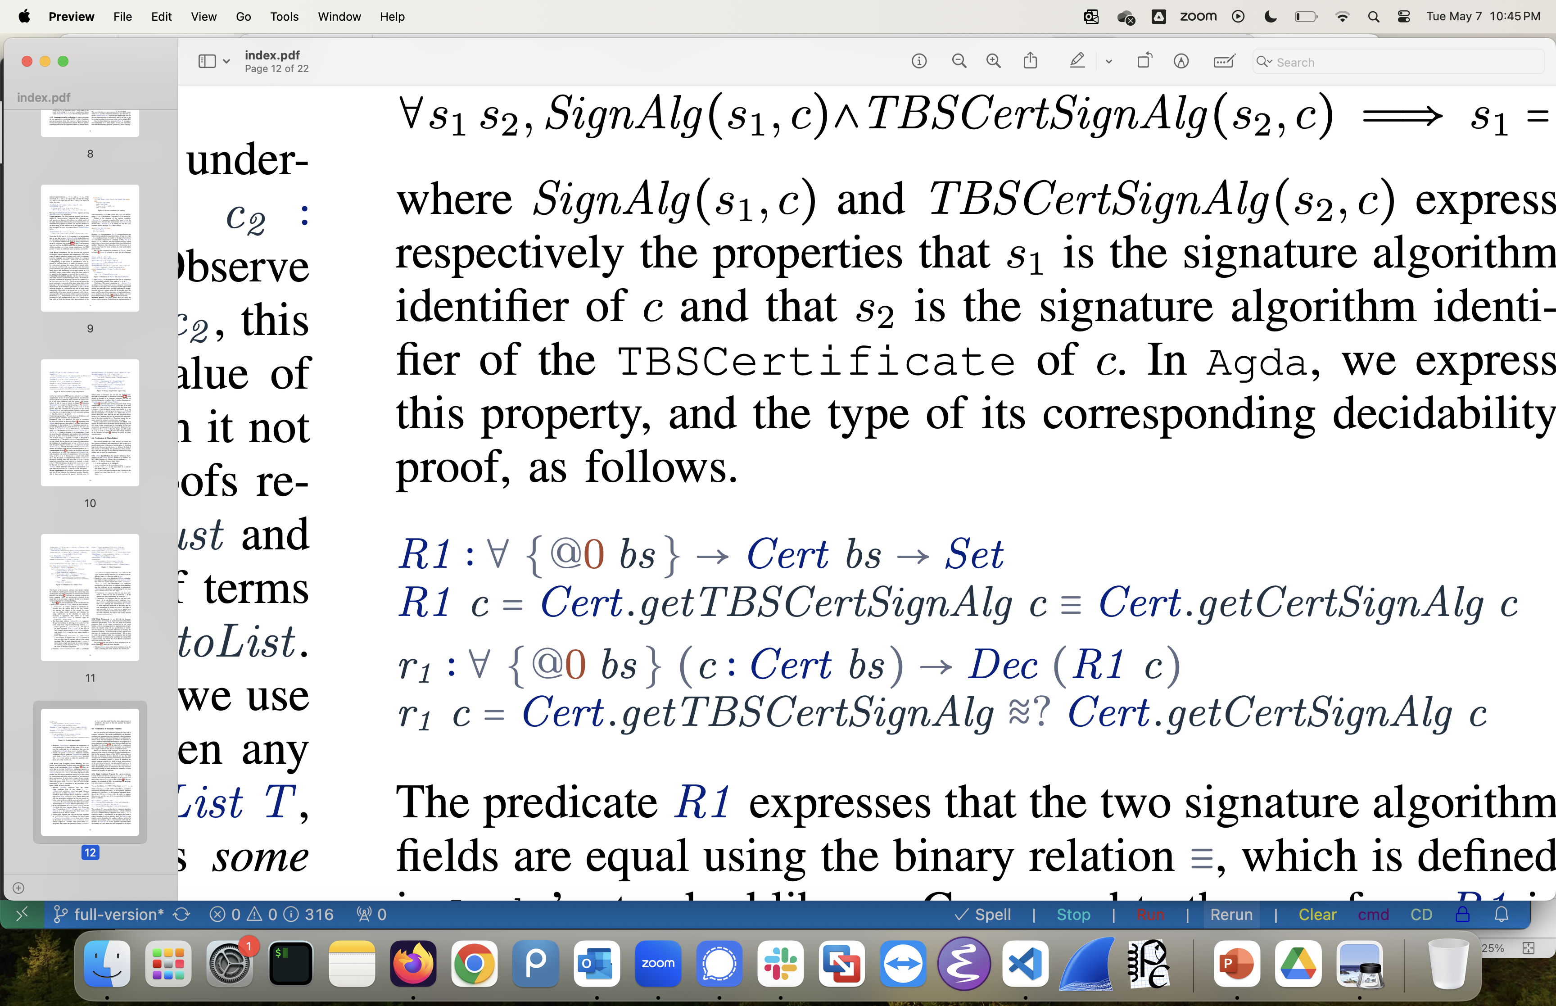
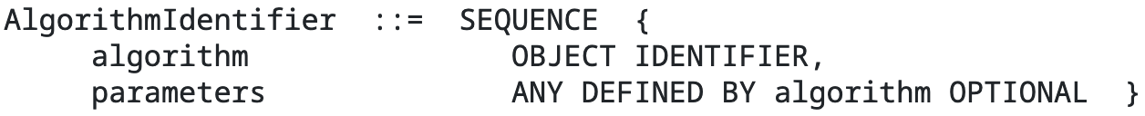
Verification of Semantic Validator

Slide 20
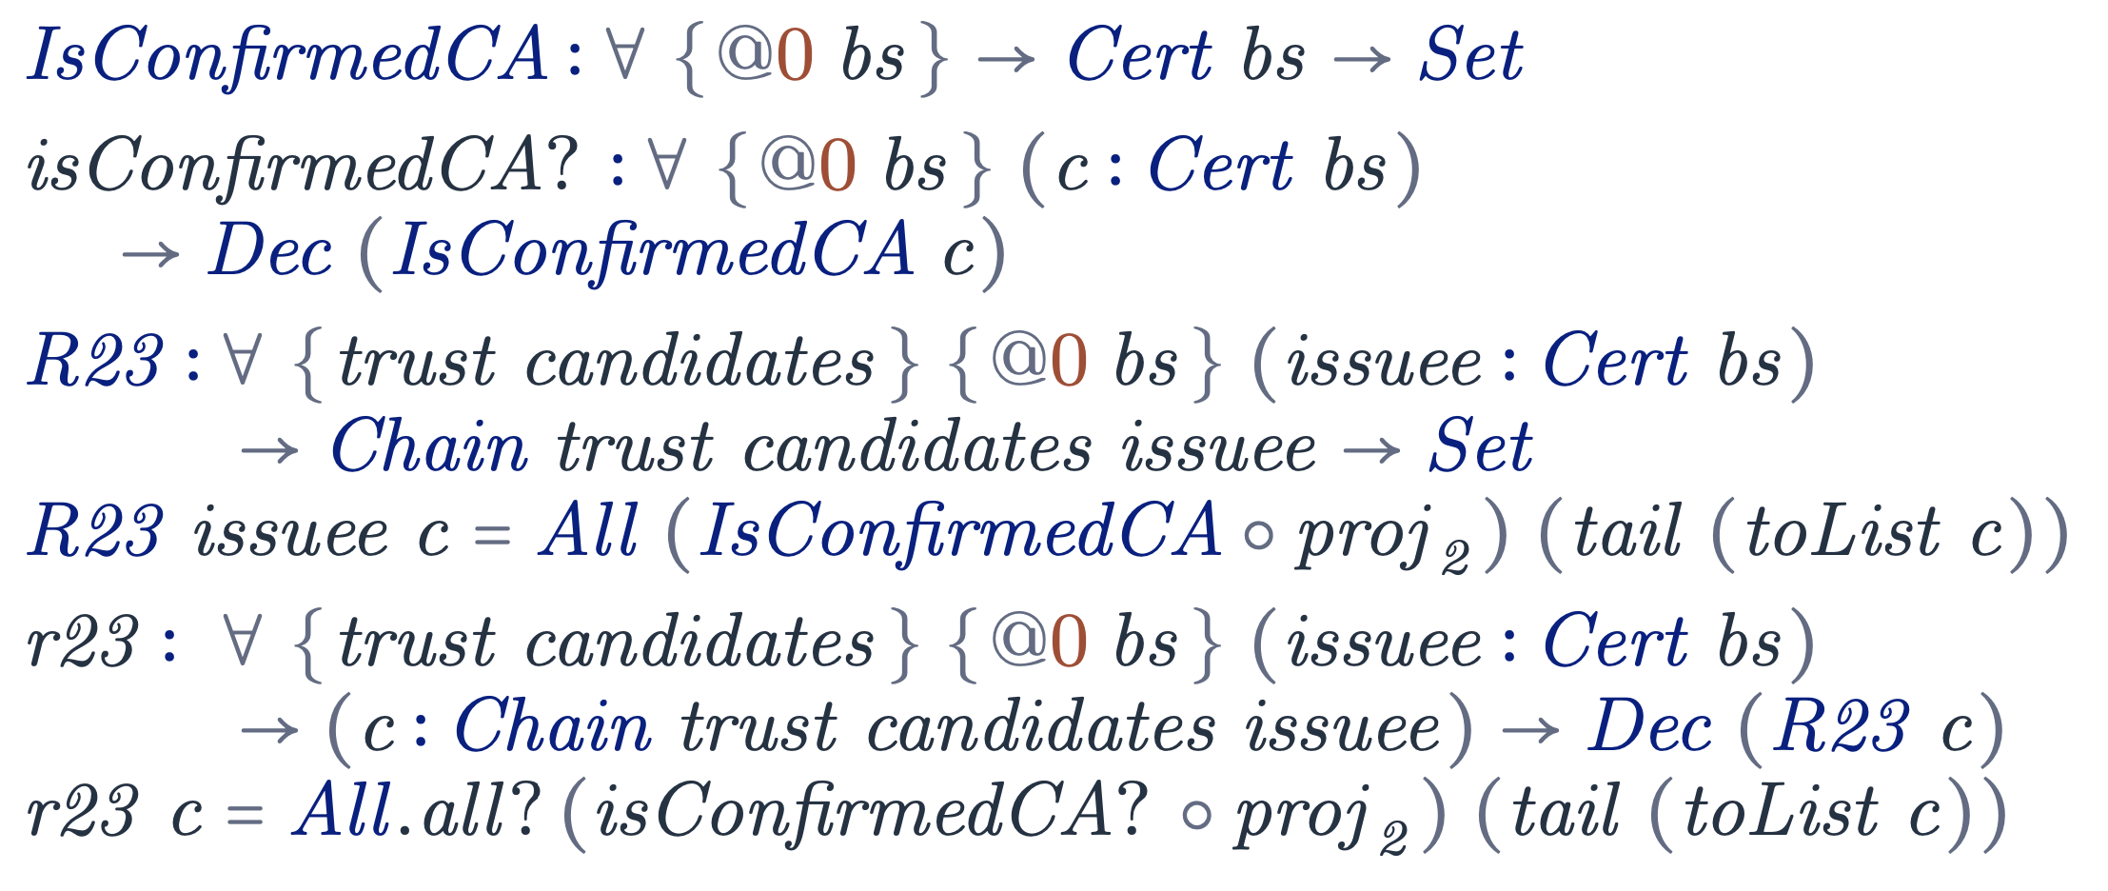
Verification of Semantic Validator
“If certificate i is a version 3 certificate, verify that the basicConstraints extension is present and that cA is set to TRUE. (If certificate i is a version 1 or version 2 certificate, then the application MUST either verify that certificate i is a CA certificate through out-of-band means or reject the certificate. Conforming implementations may choose to reject all version 1 and version 2 intermediate certificates.)”
For a certificate chain, it must be the case that every issuer certificate is a CA certificate.

Slide 21
Evaluation
Accuracy of our interpretation of the specifications
Latency and runtime overhead
Performed differential testing against 11 X.509 implementations and 1 certificate linter (zlint)
Tested with more than 4 millions real and synthetically generated certificate chains
Measured execution time and memory overhead
of each tested X.509 implementations
Integrated with BoringSSL for
latency analysis
Tested visiting 100 top websites with the Curl application

Slide 22

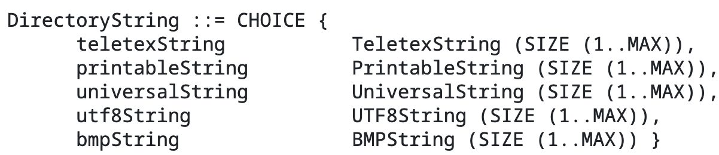
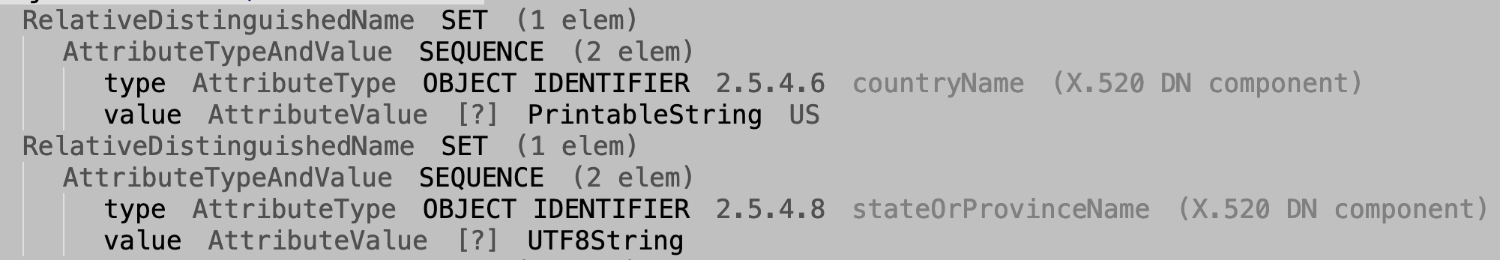

Notable Findings
ARMOR more strictly follows RFC 5280 (specification
for X.509 CCVL) than all the tested implementations
Missing length restriction
checks in Name
GnuTLS

Slide 23
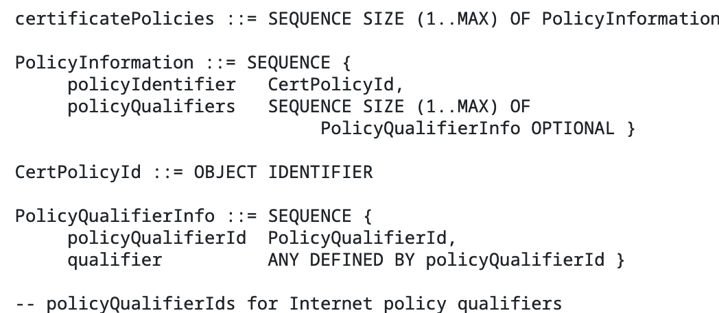
Notable Findings
ARMOR more strictly follows RFC 5280 (specification
for X.509 CCVL) than all the tested implementations
“A certificate-using system MUST reject the certificate if it encounters a critical
extension it does not recognize or a
critical extension that contains information that it cannot process.”
GnuTLS
Not rejecting unknown critical extension

Slide 24
Notable Findings
ARMOR more strictly follows RFC 5280 (specification
for X.509 CCVL) than all the tested implementations
ARMOR has a very large runtime overhead
Average execution time ~2.5 secs
Average memory overhead ~1000 megabytes

Slide 25
Takeaways
ARMOR provides higher assurance in certificate parsing and
chain validation than the existing X.509 CCVL implementations
ARMOR provides total correctness for a large subset of the X.509 CCVL
Library developers often do not strictly follow RFC 5280
Developing a fully formally verified as well as performant
X.509 CCVL implementation is still an open research problem

Slide 26
ARMOR: A Formally Verified Implementation
of X.509 Certificate Chain Validation
Joyanta Debnath¹, Christa Jenkins¹, Yuteng Sun²,
Sze Yiu Chau², and Omar Chowdhury¹
¹ Stony Brook University
² The Chinese University of Hong Kong
https://github.com/joyantaDebnath/armor/

